Slide 1
Impact of COVID-10 on NYC Taxi Industries
Problem Statement
NYC Taxi Cab Association requested Data Scientist to assess the effect of COVID on the Taxicab industry on the 2nd H 2020 and 1st H 2021.

Slide 2
Assumptions
Task will be carried out on Yellow Taxi Cap as one of the companies impacted by COVID-19
COVID-19 restrictions measure will continue for the H2-2021

Slide 3
Scope of Work
Collect the data
Data profiling and cleaning
Merge the data into one data Model (OLAP)
Conduct BI Analytics
Develop a machine learning code to predict the future

Slide 4
Data Preparation
Taking Yellow Taxi Cab sales data from Jan 2020 – Jun2020
https://www1.nyc.gov/site/tlc/about/tlc-trip-record-data.page
Taking COVD-19 data from
https://github.com/nytimes/covid-19-data/blob/master/us-states.csv
Aggregate Data from Both sources at date level and join on date key

Slide 5
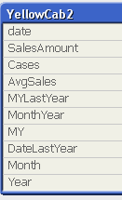
Data Model
Aggregate Data from Both sources at date level and join on date key
date | SalesAmount | Cases
20200312 | 3159825.18 | 326
20200331 | 154658.66 | 76211
20200308 | 3063791.3 | 212
20200307 | 3621673.63 | 178
20200309 | 3254180.47 | 284
20200313 | 2424903.52 | 421
20200311 | 3298933.32 | 217
20200310 | 4332005.73 | 346
20200329 | 92030.67 | 59783
20200317 | 806046.36 | 1375
20200315 | 1096629.25 | 732
20200314 | 1510703.83 | 610
20200319 | 501779.09 | 4161
20200306 | 4539602.47 | 44
Yellow Cap trip data from Jan – June 2020 contains data of out of the range such as year 2009, 2010
Data points (sales) during the COVID-19 is very small (3 months only) that is about 90 data points

Slide 6
Data Visualization
Year Month | SalesAmount_ | No of Cases
Jan | $119,538,722
Feb | $117,114,233
Mar | $56,655,174 | 464981
Apr | $3,903,168 | 6328973
May | $6,854,105 | 10850463
Jun | $9,847,968 | 11656829
Grand Total | $313,913,370 | 29301246

Slide 7
What is the Relation

Slide 8
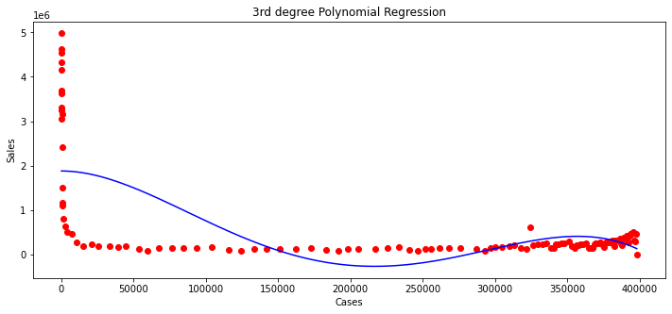
Polynomial Relation
R2 = 64
Polynomial Relation 3th degree equation is best fit.

Slide 10
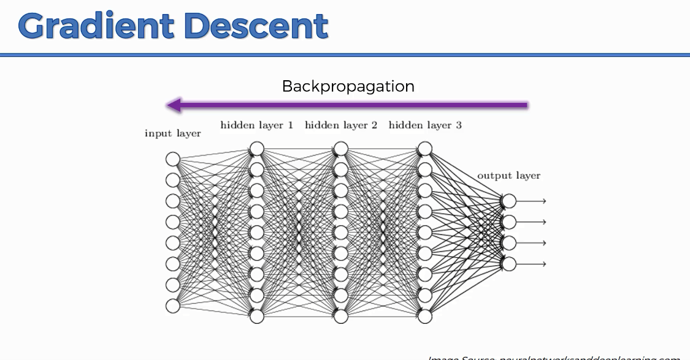
Predicting The future Sales Under COVID-19 restrictions
The Long Short-Term Memory network or LSTM network is a type of recurrent neural network used in deep learning because to learn from long sequence of observation and predict future sequence
https://www.superdatascience.com/blogs/the-ultimate-guide-to-artificial-neural-networks-ann

Slide 11
LSTM Approach
Take Data from 1st March at the time of Pandemic break out
Decide of number of days to look back and training your model timesteps= 30
Process the data train and test set
Create an array of Matrix of time series as features of RNN input
Create this Matrix for x_train and y_train
Create LTSM stacked layers model
Train the Model
Predict the future 365 days
Create data set from Jan 2020 – June 2021 and save it on file
Plot the out of the predicted sales

Slide 12
Model Summary
## Model Consist of 3 hidden layers and one output layer
model=Sequential()
# Add LSTM layer
model.add(LSTM(50,return_sequences=True,input_shape=(time_steps,1)))
model.add(LSTM(50,return_sequences=True))
model.add(LSTM(50))
model.add(Dense(1))
model.compile(loss='mean_squared_error',optimizer='rmsprop')
model.fit(X_train,y_train,validation_data=(X_test,ytest),epochs=100,batch_size=5,verbose=1)
Layer (type) Output Shape Param #
=================================================================
lstm_37 (LSTM) (None, 30, 50) 10400
_________________________________________________________________
lstm_38 (LSTM) (None, 30, 50) 20200
_________________________________________________________________
lstm_39 (LSTM) (None, 50) 20200
_________________________________________________________________
dense_13 (Dense) (None, 1) 51
=================================================================
Total params: 50,851
Trainable params: 50,851
Non-trainable params: 0

Slide 13
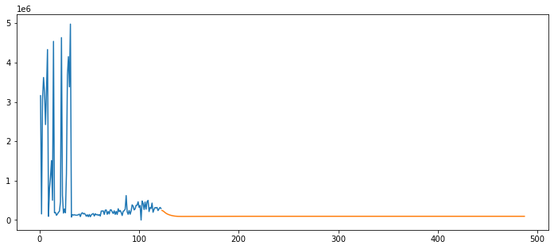
NYC Taxi Sales in the next 365
%Sale Reduction from 2020-2021 | % Sales
Jan | -87%
Feb | -92%
March | -75%
April | 318%
May | 103%
June | 27%
Year Month | SalesAmount_
2020
Jan | $141,553,616
Feb | $153,356,258
Mar | $73,392,651
Apr | $4,641,291
May | $8,395,926
Jun | $12,180,022
Jul | $16,710,885
Aug | $23,461,086
Sep | $23,817,217
Oct | $12,916,690
Nov | $14,844,591
Dec | $22,074,406
2021
Jan | $18,734,310
Feb | $12,608,695
Mar | $18,380,103
Apr | $19,403,955
May | $17,024,766
Jun | $15,463,180
Grand Total | $608,959,647

Slide 14
NYC Predicted COVID-19 Cases next 365
Year/Month | No of Cases
2020
Jan | 0
Feb | 0
Mar | 590,466
Apr | 7,939,509
May | 14,024,460
Jun | 14,766,772
Jul | 14,531,397
Aug | 16,659,969
Sep | 16,296,615
Oct | 15,233,045
Nov | 14,538,797
Dec | 15,400,734
2021
Jan | 17,703,015
Feb | 13,908,602
Mar | 15,376,260
Apr | 14,303,815
May | 16,200,596
Jun | 16,765,461
Grand Total | 224,239,511

Slide 15
Overall Taxi Industry Impact
In Case of Continues Restrictions Taken
Sales will be reduced in monthly basis by %75 up %97

Slide 16

Thank You
Code / Data Repository
https://github.com/ziadmohd/NYCYellowTaxi

